Slide 1
Core Area Advisory Board
September 18, 2025

Slide 2
ITEM 1: APPROVAL OF MINUTES
April 17, 2025
June 26, 2025
August 21, 2025

Slide 3
ITEM 2: RECOMMEND BEND DEVELOPMENT CODE CHANGES
Consideration of recommending the proposed amendments to Article XIV. Chapter 4.2 Bend Central District Design Standards to the Bend Planning Commission and the Bend City Council.
Presentation Pauline Hardie, Senior Planner

Slide 4
Bend Central District
2.7.3240 Design Standards.
A. Development in the BCD is subject to the following design standards. These standards are in addition to the regulations of BDC Chapter 4.2, Minimum Development Standards Review, Site Plan Review and Design Review, but replace design standards of the underlying zoning district and the standards in BDC 3.6.200(D), Townhomes, BDC 3.6.200(I), Residential Uses within Commercial Districts, BDC 2.3.400, Site Layout and Building Orientation and BDC 2.2.500, Site Layout and Building Orientation.
***
B. Exemption. Exterior design alterations to existing buildings are exempt from the design standards in this section and from BDC 4.2.600, Design Review.

Slide 5
4.2.600 Design Review
A. Applicability. Design Review is required for exterior alterations to existing buildings that modify 25% or more of the surface area of any exterior wall or roof where Minimum Development Standards Review or Site Plan Review is not otherwise required.
B. Exemptions. The following activities or structures are not subject to this section:
***
2. Exterior alterations to existing buildings that modify less than 25% of the surface area of any exterior wall or roof where there is no net loss of glazing.
***
5. Single-unit detached dwellings, townhomes, accessory dwelling units, duplexes, triplexes, quadplexes, single room occupancies with six or fewer units and cottage developments.
***
9. Existing buildings located in the Bend Central District (BCD). See BDC 2.7.3240, Design Standards.

Slide 6
Bend Central District Design Standards 2.7.3240(A)(3)
3. Transparency.
a. On main streets, facades that face the main street must include transparency/glazing (i.e., glass windows and/or glass doors) totaling a minimum of 40% of the ground level wall area and 20% on the upper level(s) wall area.
b. Facades that face a non-main street must include transparency/glazing (i.e., glass windows and/or glass doors) totaling a minimum of 25% of the ground level wall area and 20% on the upper level(s) wall.

Slide 7
Proposed Recommendation
Bend Central District
2.7.3240 B. Exemption. Exterior design alterations to existing buildings are exempt from the design standards in this section and from BDC 4.2.600, Design Review where there is less than (add %) net loss of glazing
4.2.600 (B)9. Existing buildings located in the Bend Central District (BCD) where there is less than (add %) net loss of glazing. See BDC 2.7.3240, Design Standards.

Slide 8
ITEM 3: CORE AREA BUSINESS PROPERTY OWNER IMPACT
A monthly update on the general economic/area impact update or proposed investment opportunities from a Core Area Urban Renewal Area business and/or property owner.
Business/Property Owner: Compass Commercial

Slide 9
ITEM 4: DRAFT OUTLINE OF THE CORE AREA INVESTMENT STRATEGY AND ACTION PLAN
A presentation and discussion about the draft Core Area Investment and Action Plan Framework.

Slide 10
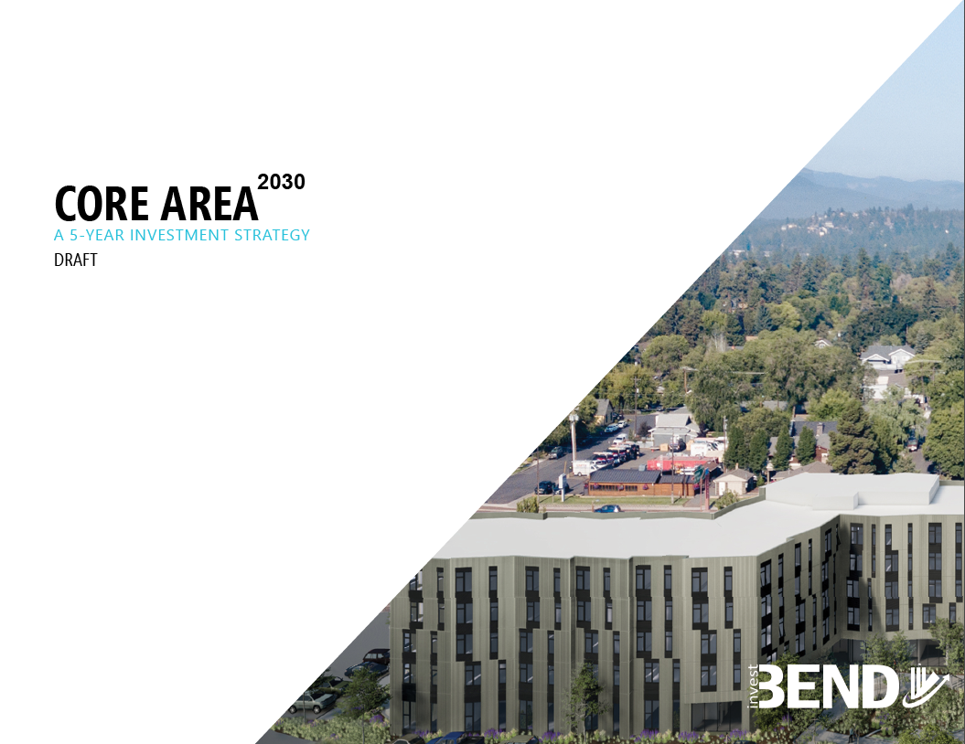

Slide 11
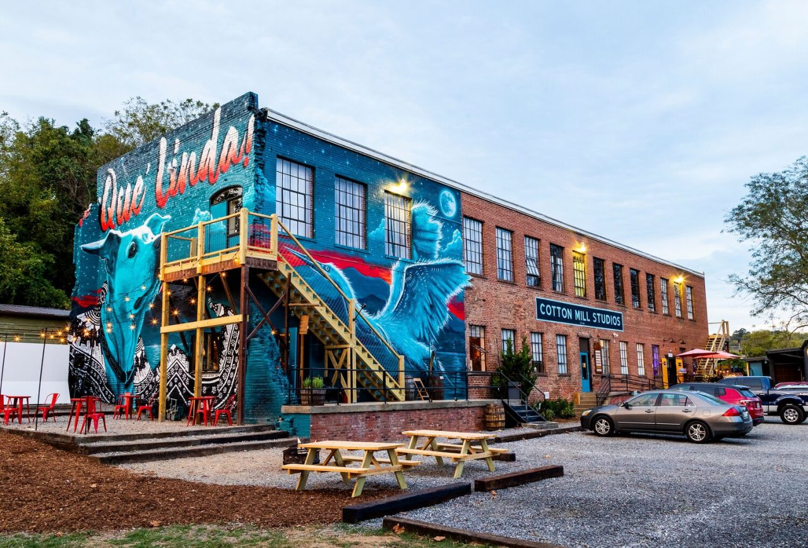
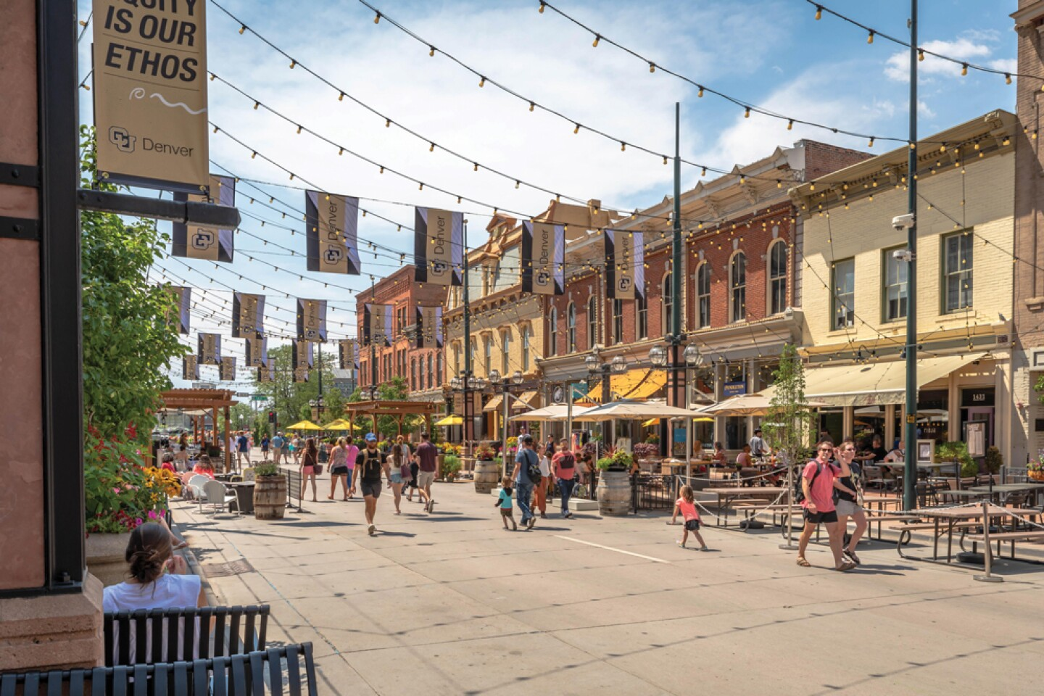
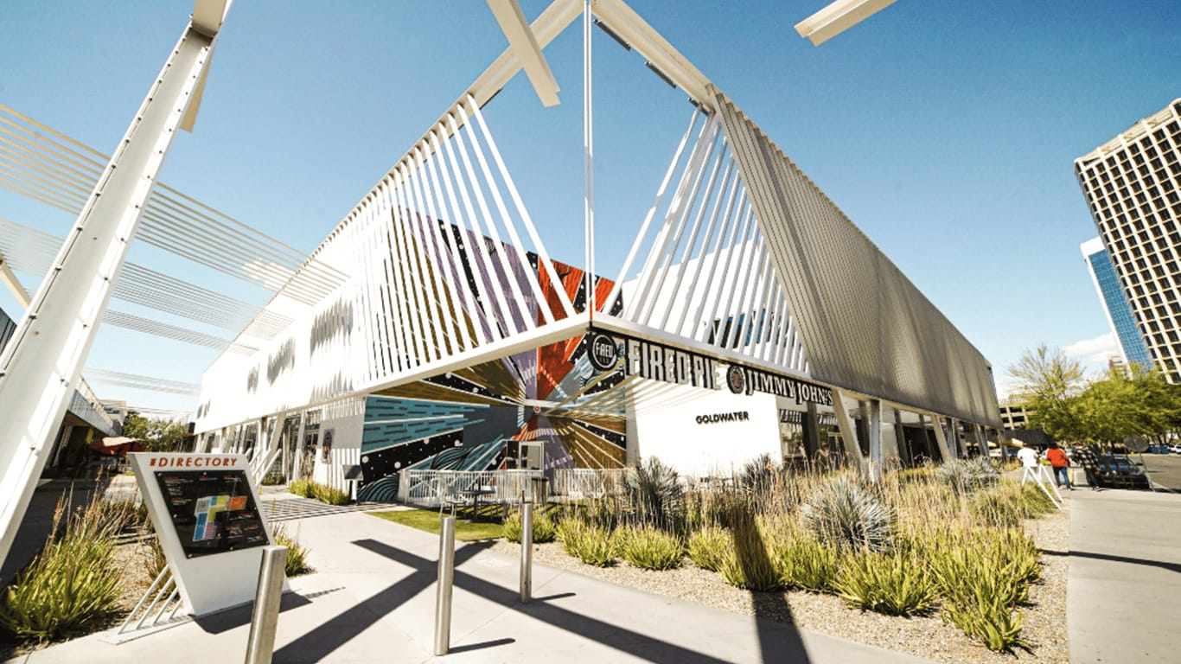
USING BEST PRACTICES TO INFLUENCE THIS STRATEGY
The River Arts District was an unused industrial area along the French Broad River. Transformed by “a riverwalk” and activated spaces. By 2017, hundreds of artists moved in, world famous restaurants opened, and several national breweries were recruited. After Helene, it has become a beacon of hope.
The $500 million Dever Union Station is that rare project that not only elevated its surroundings and connected an entire City. These 19.5-acres were left for decay until massive investment brought new office, retail, and residential developments around a freshly renovated transportation hub.
Park Central, a mid-town area in Phoenix, is hitting major milestones including new tenants, restaurants, and hotel.
Asheville, NC
Denver, CO
Phoenix, AZ

Slide 12
CORE AREA 2030
The Core Area Investment Strategy is a five-year action plan to invest tax increment, bond proceeds, and program revenue to implement the Core Area Tax Increment Finance Plan and further redevelopment the Core and Bend Central District.
CORE AREA 2030 VISION
The Bend Central District and the Core Area is an emerging safe and welcoming arts, entertainment, and business district where more people are choosing to live and new businesses are being established.
INVESTMENT SUMMARY
The Bend Urban Renewal Agency will invest and leverage $8.9 million to encourage at least three private projects that invest a total of $100 million. This will encourage more residents and businesses in the area, the relocation of the Bottle Drop, and foster an average 3% annual growth rate of assessed valuation.

Slide 13
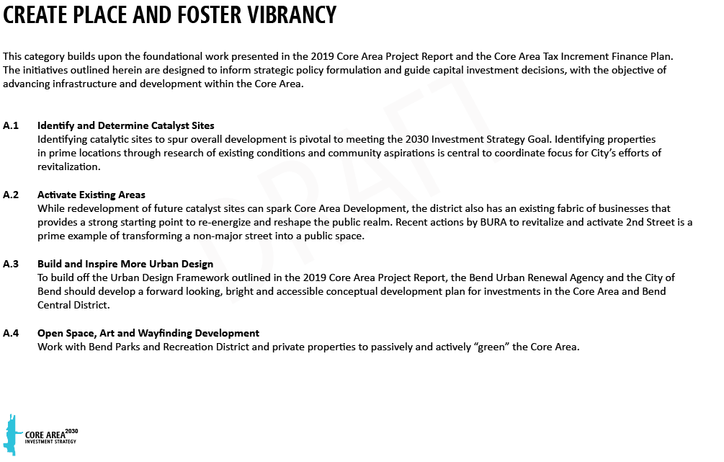

Slide 14
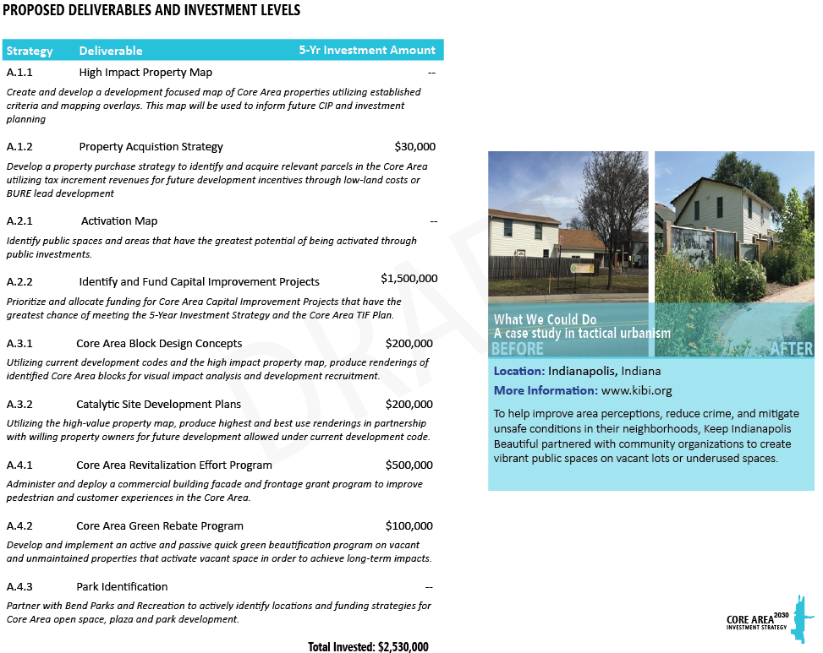

Slide 15
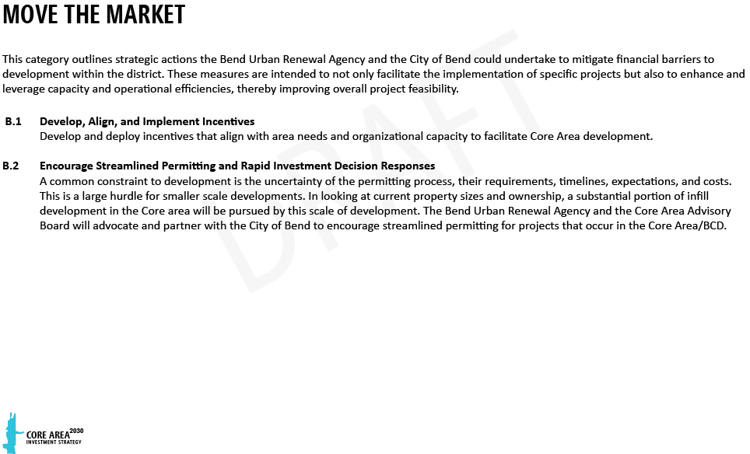

Slide 16
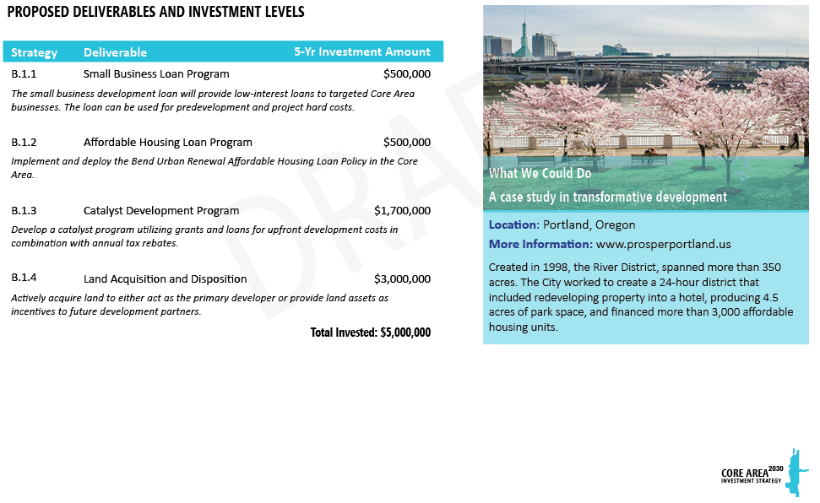

Slide 17
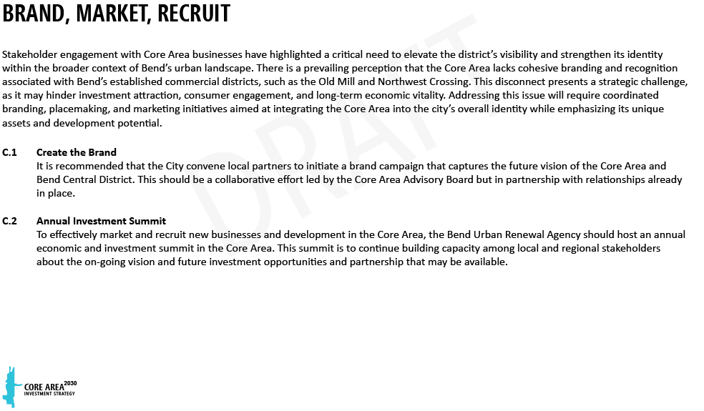

Slide 18
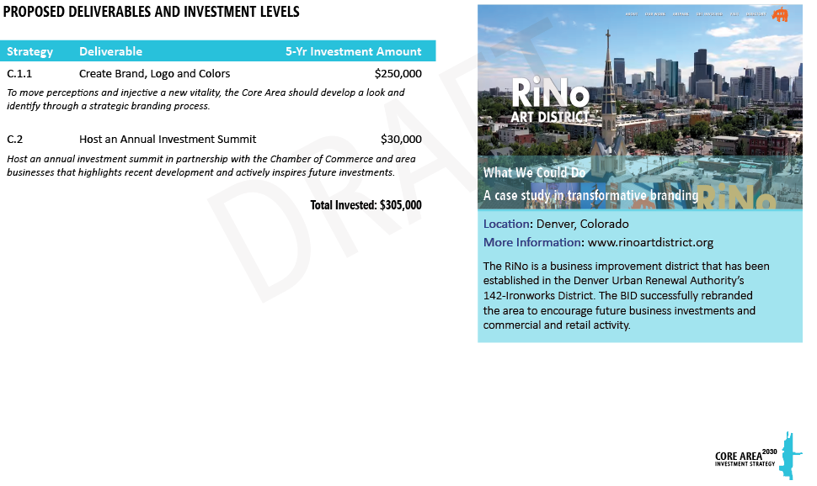

Slide 19
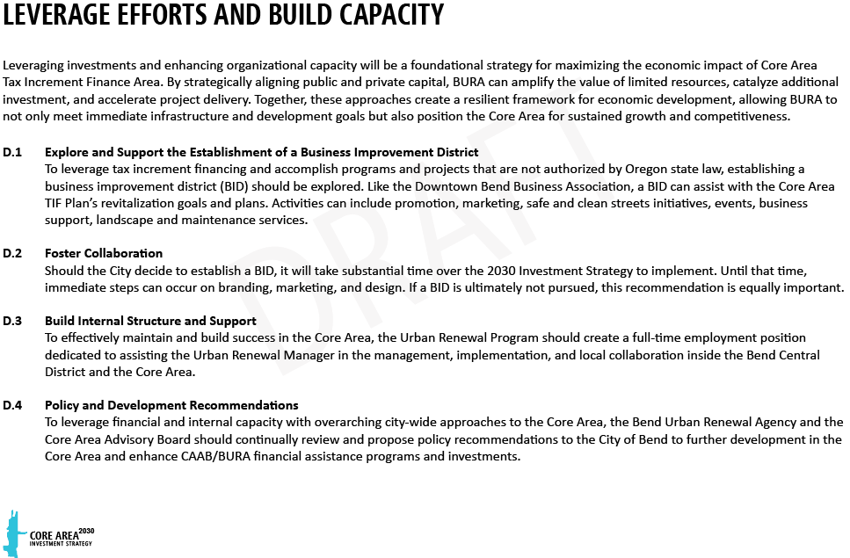

Slide 20
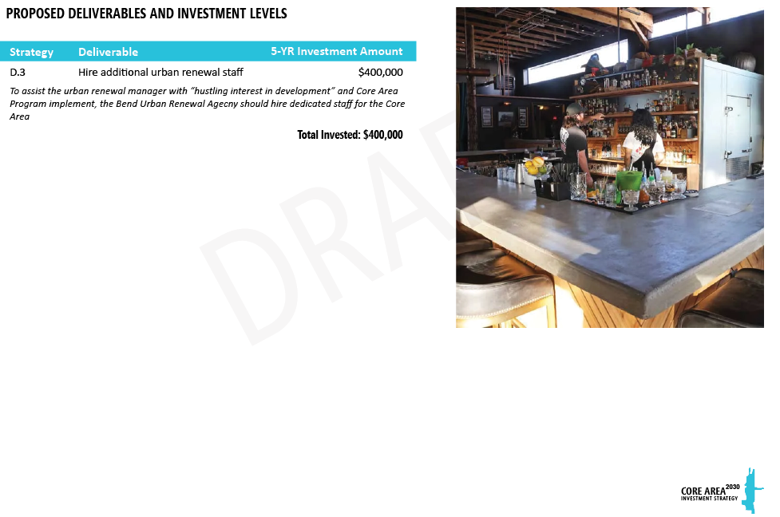

Slide 21
POLICY RECOMMENDATIONS CONVERSATIONS
FURTHER REFINED AT OCTOBER 2025 CAAB MEETING
Drake to Juniper Route via Hawthorne Crossing
Clarify timeline and resources for all City-owned properties
^{Open space/park development}
Sewer infrastructure (BURA CIP $3.9M)
Enhance CAAB/BURA Assistance – including SDC exemptions and CIP assistance from the City for BURA approved projects. Leverage limited TIF dollars
Increase internal risk-tolerance
Provide space for BURA to function (adequately schedule time for BURA to meet and consider projects.)
Establish a Business Improvement District
Expedited permit review for all projects in the Core Area until 2030
Substantially reduce or eliminate Core Area transfers to General Fund
Request reallocation of Franklin to property acquisition strategy

Slide 22
CORE AREA ADVISORY BOARD WORK PLAN
The following items are the proposed Core Area Advisory Board (CAAB) 2-Year Work Plan. CAAB will develop and implementation plan to accomplish the proposed items by December 2027. To encourage adaptability, monthly review and modifications may be recommended by CAAB to BURA.
Create high value property map.
^{Create activation map.}
Advise the Core Area Block Design and Catalytic Site Development Plans.
Develop and administer the Core Area Green Rebate Program.
Administer the Core Area Revitalization Effort Program (facade program).
Develop small business loan program.
Develop catalyst programs/incentives.
Advise on land acquisition and disposition.
Lead, in collaboration with BCD Business Owners, Core Area Branding Efforts.
Assist the City of Bend with the establishment of a business improvement district.
Assist the City of Bend with position description for Core Area urban renewal project coordinator.
Provide annual policy recommendations regarding Core Area investments and development code updates.
Assist with the preparation and making recommendations regarding the BURA Biennium Budget.

Slide 23
INVESTMENT SUMMARY EXPENDITURES
CORE AREA INVESTMENT STRATEGY FOCUS AREAS |  | 5-Year Total
Create Place and Foster Vibrancy
A.1 | Identify and Determine Catalyst Sites | $30,000
 | High Value Property Map
 | Property Acquisition Strategy
A.2 | Activate Existing Areas
 | Activation Map
 | Identify and Fund Captial Improvement Projects | $1,500,000
A.3 | Create the Urban Design and Core Area Master Plan
 | Core Area Block Designs | $200,000
 | Catalytic Site Development Plans | $200,000
A.4 | Open Space, Art, and Wayfinding Signage
 | Core Area Revitalization Grant Program | $500,000
 | Core Area Green Rebate Program | $100,000
 | Park Identification and Assistance
Move the Market
B.1 | Develop, Align, and Implement Incentives
 | Loan(s) Programs | $1,000,000
 | Catalytic Development Progarm | $1,700,000
 | Land Acquisition and Disposition | $3,000,000
B.2 | Clear and Streamlined Permitting
 | Expedited Review
 | Concierge Service
 | Investment Rapid Response Team
Brand, Market, Recruit
C.1 | Create the Brand | $250,000
C.2 | Annual Investment Summit | $30,000
Leverage Efforts and Build Capacity
D.1 | Establish a Business Improvement District
D.3 | Foster Collaboration
D.2 | Build Structure | $400,000
 | TOTAL | $8,910,000

Slide 24
 |  | 2026 |  |  |  |  |  |  |  |  |  |  |  | 2027
CORE AREA INVESTMENT STRATEGY FOCUS AREAS |  | JAN | FEB | MAR | APR | MAY | JUN | JUL | AUG | SEP | OCT | NOV | DEC | JAN | FEB | MAR | APR | MAY | JUN | JUL | AUG | SEP | OCT | NOV | DEC
Create Place and Foster Vibrancy
A.1 | Identify and Determine Catalyst Sites
 | High Value Property Map
 | Property Acquisition Strategy
A.2 | Activate Existing Areas
 | Activation Map
 | Identify and Fund Captial Improvement Projects
A.3 | Create the Urban Design and Core Area Master Plan
 | Core Area Block Designs
 | Catalytic Site Development Plans
A.4 | Open Space, Art, and Wayfinding Signage
 | Core Area Revitalization Grant Program
 | Administer
 | Core Area Green Rebate Program
 | Develop
 | Recommend
 | Administer
 | Park Identification and Assistance
Move the Market
B.1 | Develop, Align, and Implement Incentives
 | Loan(s) Programs
 | Develop
 | Recommend
 | Catalytic Development Progarm
 | Research
 | Develop
 | Recommend
 | Implement
 | Land Acquisition and Disposition
 | Research
 | Identify
Brand, Market, Recruit
C.1 | Create the Brand
C.2 | Annual Investment Summit
Leverage Efforts and Build Capacity
D.1 | Establish a Business Improvement District
D.3 | Foster Collaboration
D.2 | Administer
Administration
E.1 | Budget Committee

Slide 25
Language Assistance Services & Accommodation Information for People with Disabilities
You can obtain this information in alternate formats such as Braille, electronic format, etc. Free language assistance services are also available. Please contact [Project Manager or Document Creator] at [email] or [telephone number]. Relay Users Dial 7-1-1.
Servicios de asistencia lingüística e información sobre alojamiento para personas con discapacidad
Puede obtener esta información en formatos alternativos como Braille, formato electrónico, etc. También disponemos de servicios gratuitos de asistencia lingüística. Póngase en contacto con [Gestor del proyecto o creador del documento/Project manager or Document Creator] en [correo electrónico/email] o [número de teléfono/telephone number]. Los usuarios del servicio de retransmisión deben marcar el 7-1-1

