Slide 1
Question to the Board
“Should we eliminate the presentation requirement for Business Assistance Applicants?”
Yes (Pros)
  It is not in the Policy for award process.
  Simplifies the timeline, eliminates an extra meeting
  Based on documents submitted, most equitable.
    Some may not be good at presentations or have the time to conduct one.
    Our Latino Outreach says this would pose a challenge to applicants.
  Because it’s a matching grant program, interviews may be an overreach.
No (Cons)
  Allows for potential creativity in applicant’s proposal.
  If someone is not good at writing, one may be good at speaking.

Slide 2
Midtown Crossings
Garrett C Sabourin, GO Bond Principal Engineer
October 19, 2023

Slide 3
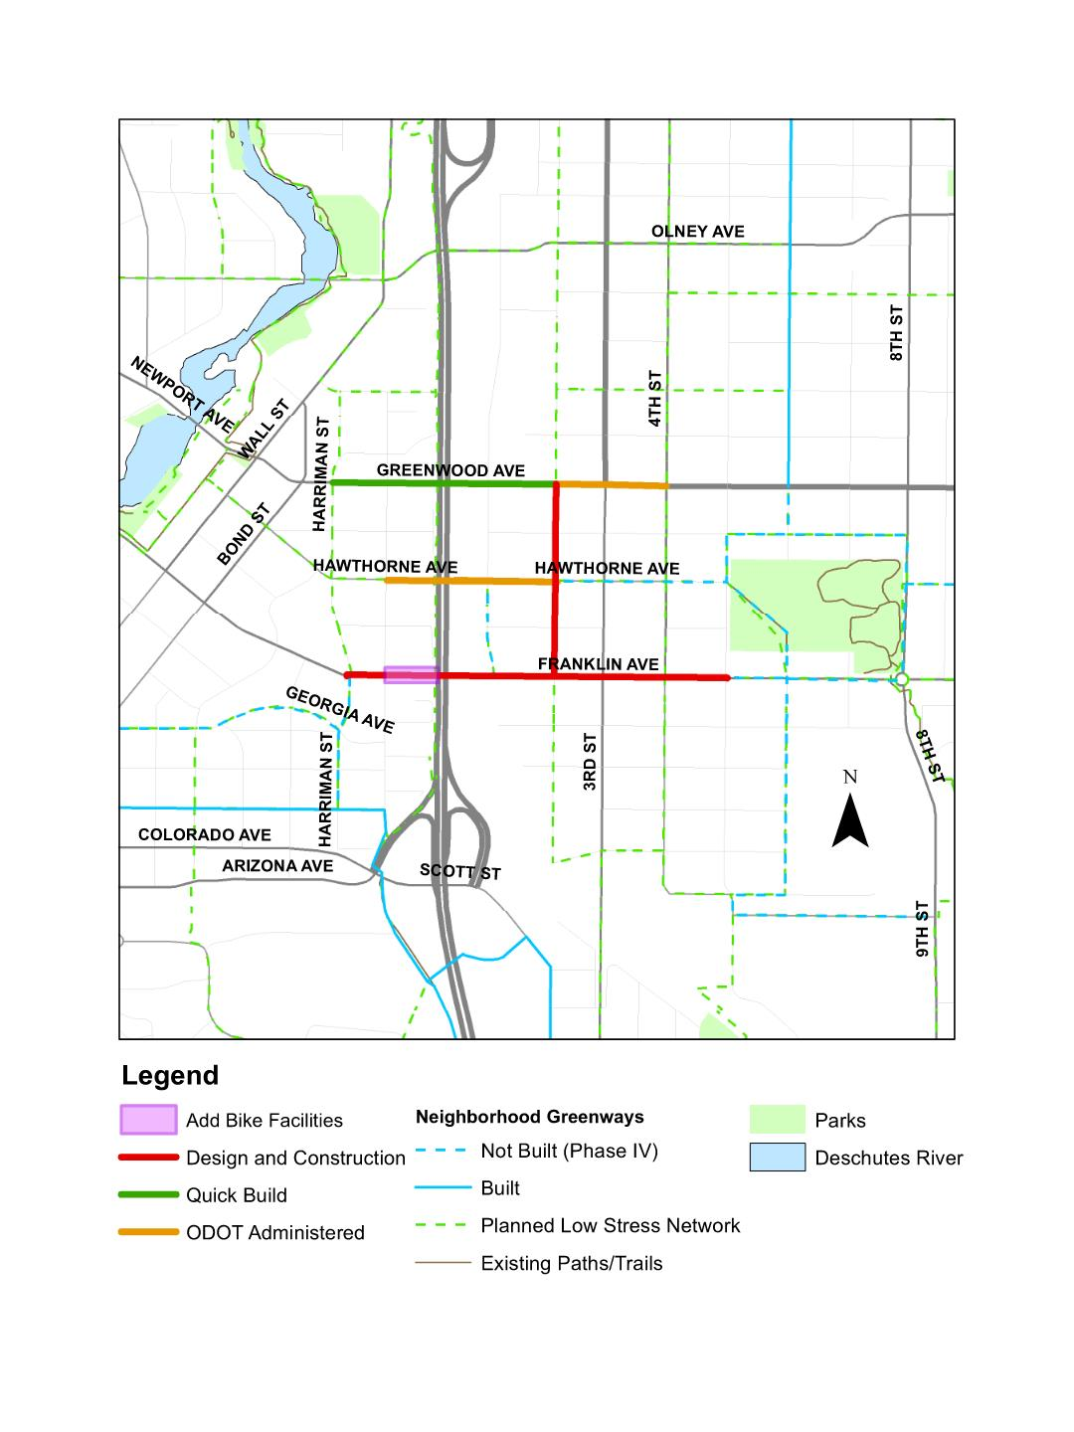
Midtown Projects
1. Oregon DOT Administered Projects (Federal/State Funds)
  Hawthorne Overcrossing: Harriman to 2nd Strees Greenwood Ave: 2nd to 4th
2. City Administered Midtown Projects
  Greenwood Quick-Build (Phase I): Harriman to 2nd St
  2nd Street: Greenwood to Franklin
  Franklin Corridor: Harriman to 5th
  Hawthorne Concept Refinement
3. Remaining Midtown Projects – Funding Dependent
  Greenwood Full-Build (Phase II)*
  Hawthorne Corridor: Juniper to Drake Parks
  *Greenwood quick-build monitored for one-year prior to full-build option considerations
Notes:
Quicker option, hybrid option to address tboc/caab recommendations
Not enough funding for Hawthorne, which is also a much longer project to deliver
Continue to pursue grants and more TIF coming as development takes hold in Core.
Greenwood:
2nd/Greenwood improvement
Identify other improvement opportunities in combination with stormwater improvements

Slide 4
ESTIMATED PROJECT SCHEDULE
Corridor | 2023 | 2024 | 2025 | 2026 | 2027 | 2028 | 2029 | 2030
Greenwood Quick-Build (Phase I)
Install Quick-Build
Second Street
DESIGN
CONSTRUCTION
City Led Progressive Design-Build Contract
Franklin Ave
DESIGN
CONSTRUCTION
Hawthorne Concept Refinement
Concept Refinement Complete
ODOT: Hawthorne Overcrossing
DESIGN
CONSTRUCTION
ODOT: Greenwood ARTS
DESIGN
Construction Complete: 2nd to 4th
*Schedule to be refined following procurement of design and construction services
**City of Bend facilitated projects under sole progressive design-build project

Slide 5
Funding (Hawthorne & BURA)
Grant Program | Awarding Agency | Amount | Matching Amounts (local/state funds) | Obligation Req's | Scope Restrictions
Lottery Bonds Bill (HB 5030) | State | $5,000,000 | None | TBD upon official notification of fund transfer | Overcrossing or corridor design and/or construction
RAISE | Federal | $19,560,000 | 20% of project cost in non-federal funds ($4.89M) | Obligated by Sept 2027; Expended by Sept 2032 | Overcrossing/Bridge
*Other potential grants include: Oregon Community Paths, Federal Community Funding
CIP Fund | Project | 23/24 | 24/25 | 25/26 | 26/27 | 27/28
BURA CORE | 2nd Street | $500k | $1.0M | $1.0M
 | Franklin | $500k | $2.5M
 | Hawthorne |  |  |  | $1.5M | $1.5M

Slide 6
NEXT STEPS
Secure Grant Awards and receive City Council approval
Initiate City administered Midtown Connections Project
  Includes:
    Greenwood Quick-Build
    2nd Street, Franklin Ave (Harriman to 5th)
    Hawthorne Overcrossing Concept Refinement.
  Current Schedule:
    December 2023: Council award
Working with ODOT to manage and facilitate federal funds for design and construction of Hawthorne Overcrossing
  Anticipating FHWA Agreement approval in January 2024
City Council upcoming updates:
  Greenwood Quick-Build Performance/Feedback
  Hawthorne Concept Refinement
  Budget Refinement with actual construction costs

Slide 7
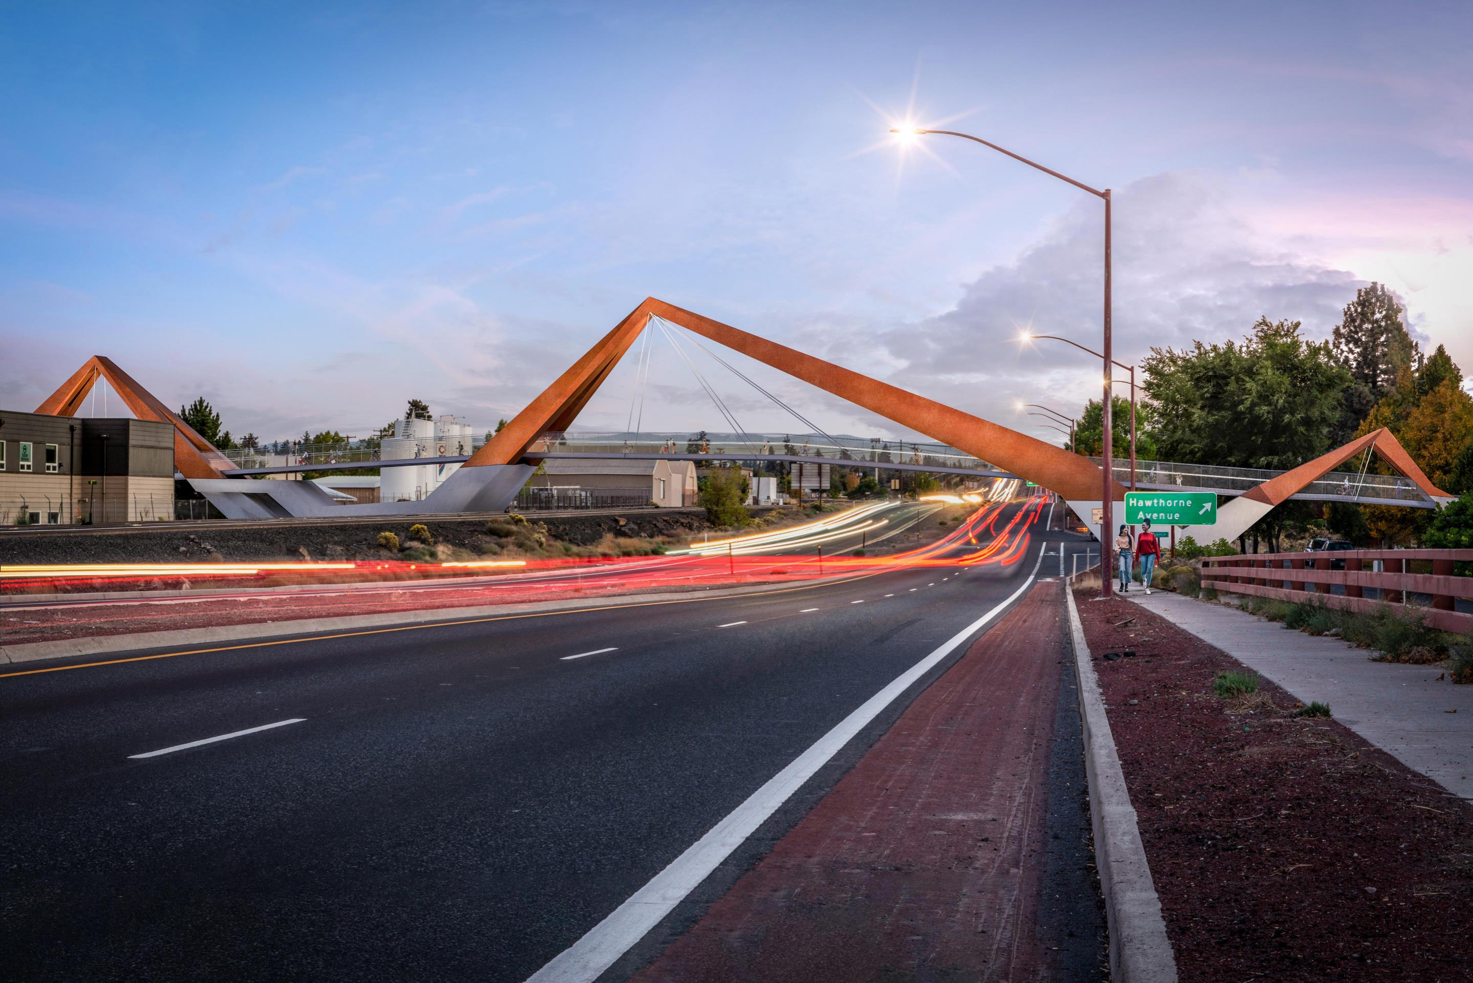
Hawthorne Overcrossing Direct Approach

Slide 8
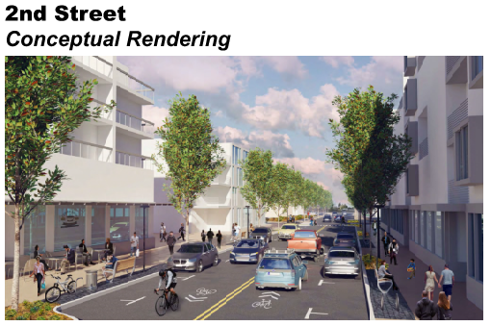
*Reference Core Area Report (Action plan for Core Area)

Slide 9
To obtain this information in an alternate format such as Braille, large print, electronic formats, etc. please contact [Project Manager or Document Creator] at [email] or [telephone number]; Relay Users Dial 7-1-1.

