Slide 1
TRUAC Meeting #5
Renee Brooke, Planning Manager
Pauline Hardie, Senior Planner
August 30, 2023

Slide 2

Agenda
Roll Call
Declaration of Potential Conflicts
Preservation Requirements for Regulated and Priority Trees
Mitigation Options
  On-Site Tree Replacement
  Fee In-Lieu of Preservation
Next TRUAC meeting September 20, 2023, 12-2 P.M.

Slide 3
Council Direction
Provide consistency between BMC Chapter 16.10, Clearing, Grading, and Erosion Control on Construction Sites, BDC Chapter 3.2, Landscaping, Street Trees, Fences and Walls and City of Bend Standards and Specifications Chapter 12, Landscape Architecture and Irrigation Systems
Provide clear and objective tree preservation standards for the development of housing, including needed housing, and include an optional discretionary process for applicants for development;
Consider preservation standards for larger trees similar to the Southeast Area Plan; and
Consider alternatives to preserving trees, including tree replacement and a fee-in-lieu of preservation for the purpose of developing and protecting the City’s urban tree canopy.
Identify tree inventory programs to support preserving and expanding Bend’s urban tree canopy.

Slide 4
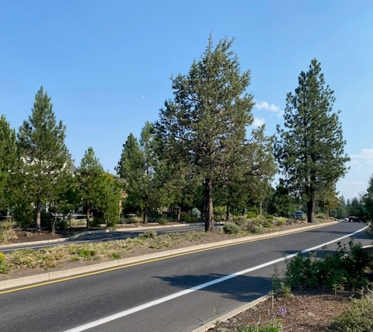
Decisions from Previous Meeting
Inventoried and Mapped Trees (Regulated Trees)
  6” or larger (Deciduous and Coniferous)
Priority Trees
  20” or larger (Deciduous and Coniferous)

Slide 5
Preservation Options

Slide 6
 | Sky Vista Single-Unit 9.13 Acres | Poplar Cottages 0.54 Acres | Century Mixed-Use 1.50 Acres | Veridian Multi-Unit 2.81 Acres | Caraway Master Plan (Phase 1) 16.81 Acres | Parkside Place Master Plan 37.10 Acres | Bri Multi-Unit 2.23 Acres | Bulletin Multi-Unit 1.57 Acres
DBH
Actual On-Site DB | 1739 | 715 | 897 | 968 | 3484 | 2564 | 324 | 362
Actual Preservation | 44 | 207 | 0 | 144 | 1352 | 392 | 233 | 206
20% | 347.8 | 143 | 179.4 | 193.6 | 696.8 | 512.8 | 64.8 | 72.4
25% | 434.75 | 178.75 | 224.25 | 242 | 871 | 641 | 81 | 90.5
30% | 521.7 | 214.5* | 269.1 | 290.4 | 1045.2 | 769.2 | 97.2 | 108.6
* save one more 8” tree
Trees 20" or Greater
Actual Trees 20”+ | 30 | 12 | 14 | 14 | 15 | 39 | 5 | 6
Actual Preservation | 2 | 1 | 0 | 3 | 6 | 11 | 5 | 5
20% | 6 | 2.4 | 2.8 | 2.8 | 3 | 7.8 | 1 | 1.2
25% | 7.5 | 3 | 3.5 | 3.5* | 3.75 | 9.75 | 1.25 | 1.5
30% | 9 | 3.6 | 4.2 | 4.2 | 4.5 | 11.7* | 1.5 | 1.8
* save one more 20” tree or round down

Slide 7
Tree Replacement

Slide 8
Replacement Options
City | Replacement (Remove: Replace) | Size (minimum)
Gresham, OR | Trees 24” in diameter or larger must be replaced at the rate of 1 caliper inch per 4” of tree removed, and in no case shall that result in fewer than 1 replacement tree for each tree removed.
Sandy, OR | 1:2 | Deciduous: 1.5" caliper Conifers: 5' in height
Redmond, WA | 1:1 | Deciduous: 2 ½” caliper Evergreens: 6’ in height
Edmond, WA | 6" to 10“ DBH - 1:1 | Deciduous: 2 ½” caliper Evergreens: 6’ in height
 | 10.1" to 14” DBH - 1:2
 | Greater than 14" & less the 24“ - 1:3
Coeur d’Alene, ID | 1:1 | Deciduous: 1" caliper Evergreens: Height of 4'
Boise, ID | Trees 4” caliper or greater must be replaced with an equal replacement of the total caliper inches lost. Example: two 10” caliper trees removed may be mitigated with four 5” caliper trees, five 4” caliper trees, or seven 3” caliper trees.
Notes:
Sisters, OR
3:1 (significant tree = 8” or greater)
2” caliper

Slide 9
Replacement Options Summary
Tree replacement ratio regardless of size of tree removed
    1:1 or 1:2
Tree replacement ratio based on tree size removed6" to 10“ - 1:1
    6" to 10“ DBH - 1:1
    10.1" to 14” DBH - 1:2
    Greater than 14" & less than 24“: 1:3
3. Replace with an equal caliper lost
  Example: two 10” caliper trees removed may be mitigated with four 5” caliper trees, five 4” caliper trees, or seven 3” caliper trees.
Notes:
Can option #3 be DBH instead of caliper

Slide 10
Fee in Lieu

Slide 11
Fee in Lieu of Tree Preservation Options
The fee must cover the cost of a tree, installation (labor and equipment), maintenance and fund administration.
Sandy and Oregon City, OR and Redmond WA: $500
Gresham, OR: $600
Portland, OR:
  12” to 20”: $1,800
  20” or greater: $450 per inch
  Edmond WA: $1,000 for 6” to 24” and appraised value for greater than 24” (The fee is for each required replacement tree not planted on-site)
Notes:
A tree replacement fee is required for each replacement tree required but not planted on site.
Sandy - 3 trees per acre, 11" DBH for subdivisions & 8" for land development such as commercial, industrial, and apartment sites.
Redmond, WA - 35% have to be retained that are 6" in diameter at breast height (d.b.h.),

Slide 12
Fee In-Lieu of Tree Preservation Fund Options
Purchasing, planting and maintaining trees, including irrigation, throughout the city.
  Plant trees along streets with limited tree canopy.
  Plant trees in tree-deficient neighborhoods.
  Plant trees in City-owned parks, opens spaces and rights-of-ways.
Tree inventory technology
Other ideas?

Slide 13
To obtain this information in an alternate format such as Braille, large print, electronic formats, etc. please contact Isaak Staats at istaats@bendoregon or 541-388-5547; Relay Users Dial 7-1-1.

Slide 14
Every regulated tree preserved over the required preservation percentage in subsection XX can count towards an equal replacement of the total DBH lost of priority trees. Example: two 20" DHB priority trees removed may be mitigated by preserving four 10" DBH trees or five 8” DHB trees.

Slide 15
Fee in Lieu of Tree Preservation Options
Oregon City | $500
Sandy | $500
Portland (Precent based) | 12 to 20”: $1,800 20” or greater: $450 per inch
Gresham | $600
Redmond, WA | $500
Edmond WA | $1,000 for 6” to 24” and appraised value for greater than 24”
Notes:
Sandy - 3 trees per acre, 11" DBH for subdivisions & 8" for land development such as commercial, industrial, and apartment sites.
Redmond, WA - 35% have to be retained that are 6" in diameter at breast height (d.b.h.),

Slide 16
Funds generated by fees in lieu of tree replacement shall be used to fund the City’s urban forestry program with eligible costs including staff costs, land acquisition for the purpose of planting trees, professional services, public works, and any other costs associated with the City’s urban forestry program including, but not limited to, tree planting, tree maintenance, tree irrigation, sidewalk repair limited to those sidewalks specially damaged by trees, tree inventory technology, or tree planning administration.

Slide 17
Oregon City
Applicants for review shall comply with these requirements through one or a combination of the following procedures:
A Option 1—Mitigation. Retention and removal of trees, with subsequent mitigation by replanting pursuant to OCMC 17.41.060;
B.Option 2—Dedicated Tract. Protection of trees or groves by placement in a tract within a new subdivision or partition plat pursuant to OCMC 17.41.080;
C.Option 3—Restrictive Covenant. Protection of trees or groves by recordation of a permanent restrictive covenant pursuant to OCMC 17.41.110; or
D.Option 4—Cash-in-lieu of planting pursuant to OCMC 17.41.120.
Size of Tree Removed (DBH) | Column 1 Number of Trees to be Planted (If removed outside of construction area) | Column 2 Number of Trees to be Planted (If removed within the construction area)
6 to 12" | 3 | 1
13 to 18" | 6 | 2
19 to 24" | 9 | 3
25 to 30" | 12 | 4
31 and over" | 15 | 5

Slide 18
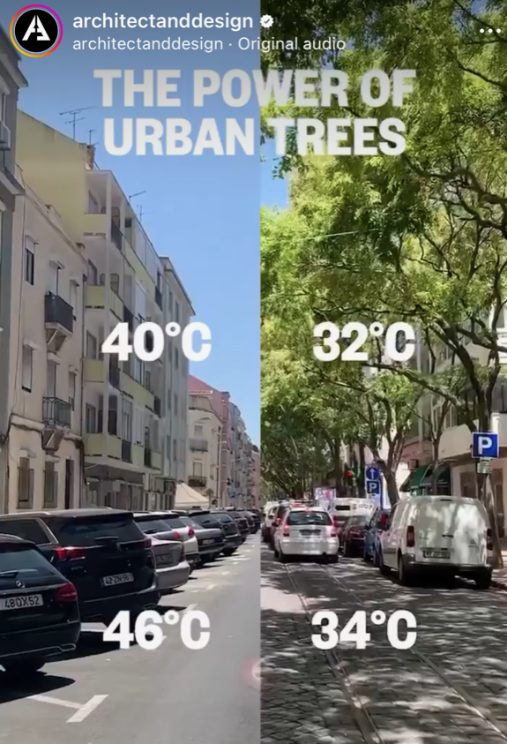

Slide 19
Other Option
Perimeter Trees: Priority trees w/in the required setbacks must be preserved; except for the siting & placement of driveway & road access, vision clearance areas, utilities, sidewalks or pedestrian walkways, or storm drainage facilities & other similar required improvements.
Notes:
Perimeter Trees: Significant trees w/in 20' of the lot perimeter/required buffer, whichever is greater, shall be preserved; except for the siting & placement of driveway & road access, buildings, vision clearance areas, utilities, sidewalks or pedestrian walkways, or storm drainage facilities & other similar required improvements, subject to the discretion of the Director.

Slide 20
Incentives – Could do for 6-19, and 20” and larger
(b) Retention of Trees in Excess of Requirements and Located Outside Critical Areas and Associated Buffers. The permanent preservation of a healthy significant tree pursuant to this section shall receive a tree replacement credit as follows:
(i) Every additional significant tree retained over the required retention percentage required by subsection (1) of this section shall be rewarded a tree credit equal to one replacement tree.
(ii) Every additional landmark tree retained over the required retention percentage required by subsection (1) of this section shall be rewarded a tree credit equal to two replacement trees.
(iii) Every additional heritage tree retained over the required retention percentage required by subsection (1) of this section shall be rewarded a tree credit equal to three replacement trees.

