Slide 1
Tree Regulation Update Advisory Committee (TRUAC)
Pauline Hardie, Senior Planner
Community and Economic Development Department
June 26, 2023

Slide 2
Tree Regulation Code Update
March 15: Council directed staff to prepare code updates to regulate trees with development applications.
Provide consistency between codes and standards and specifications.
Provide clear and objective tree preservation standards for development of housing and add an optional discretionary process.
Consider preservation standards for larger trees (e.g., Southeast Area Plan).
Consider alternatives to preserving trees, including tree replacement and a fee-in-lieu of preservation for the purpose of developing and protecting the City’s urban tree canopy.
Requested formation of a committee to advise and make recommendations on potential code updates.
Was interested in tree inventory programs to support preserving and expanding Bend’s urban canopy once the amendments are adopted.
April 14: Stewardship Subcommittee discussed the formation of a temporary committee, project scope & timeline.
May 3: Council adopted Resolution 3323 creating the Tree Regulation Update Advisory Committee (TRUAC)

Slide 3
Council Temporary Committees
Council may establish temporary committees by resolution to address specific issues or to engage in specific tasks, within identified time frames, to make recommendations to Council.
  Examples: Task forces, ad hoc or advisory committees
Scope and responsibilities are established in the enabling resolution
Subject to Public Meetings Law since they will be making a recommendation to Council
  Meetings open to the public
Committee makes recommendations, Council makes decisions (e.g., follow the committee’s recommendations, change the recommendations, reject the recommendations, refer the action back to the committee or take any other action the Council deems appropriate)

Slide 4
Group Size & Make Up
Temporary Committee
  11 – 15 members, with staff support
Liaison Members
City Councilor and Planning Commissioner
Ex Officio Member
Bend Park and Recreation District staff member
City of Bend Committee Members
Human Rights and Equity Commissioner, Environmental and Climate Committee Member and Affordable Housing Committee Member
Other Members
Arborist(s), developers of affordable housing, production housing and/or commercial projects, and community members at large including members from one or more community organizations
Staff Support
Planning, Engineering, Code Enforcement, Fire, Legal, Utilities and others as needed

Slide 5

TRUAC – Council Appointed Member June 21st
Kathy Austin – Affordable Housing Advisory Committee, architect
Kavi Chokshi – Environment and Climate Committee
Manoj Alipuria – Human Rights and Equity Commission
Gina Franzosa – River West Neighborhood Association
Brett Huett – Arborist
Chris Madison – Arborist
Cory Bittner – Pahlisch Homebuilders
Morgan Greenwood – Central Oregon Builders Association
Erik Huffman – Civil Engineer
Geoff Harris – Solaire Homebuilders
Kristin Sabo – Central Oregon Land Watch
Karon Johnson – Old Farm Neighborhood Association
Jim Roberts – At Large
Mitch Lex – Master’s degree from Oregon State University in Natural Resources
Dan Jenkins – Landscape architect
Three non-voting members that will serve as liaisons to the committee
Bend Mayor Pro-Tem Megan Perkins – City Council
Sara Anselment - Bend Parks and Recreation District
Sue Gordhammer - Bend Planning Commission
Notes:
Tell council during the presentation that you’ve received letters of interest, and that it is the staff recommendation that we tell people about the process and let them submit letters to the slot of interest, with a deadline, unless the mayor/council want another process.

Slide 6
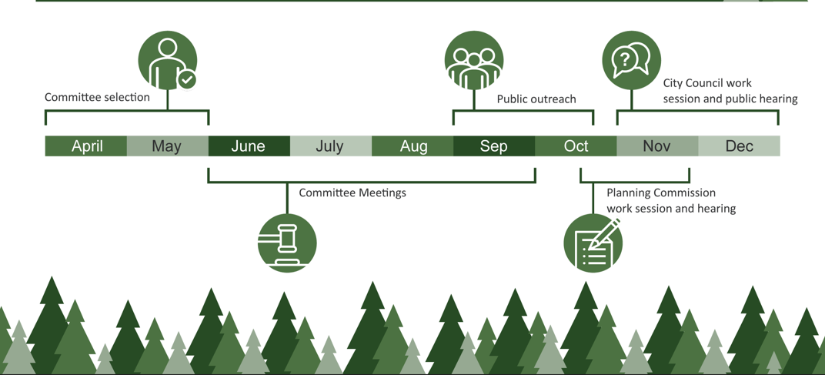
Tree Regulation Code Update Timeline

Slide 7
Next Steps
Meeting Schedule (Council Chambers and Virtually):
1st Meeting - June 28, 1-3 PM
2nd Meeting - July 11, 1-3 PM
3rd Meeting - July 27, 4-6 PM
4th Meeting – August 17, 3-5 PM
5th Meeting - August 30, 12-2 PM
Tree Regulation Code Update | City of Bend (bendoregon.gov)
https://www.bendoregon.gov/city-projects/community-priorities/tree-preservation-code

Slide 8
To obtain this information in an alternate format such as Braille, large print, electronic formats, etc. please contact Pauline Hardie at phardie@bendoregon.gov or 541-693-2153; Relay Users Dial 7-1-1.

